Slide 1
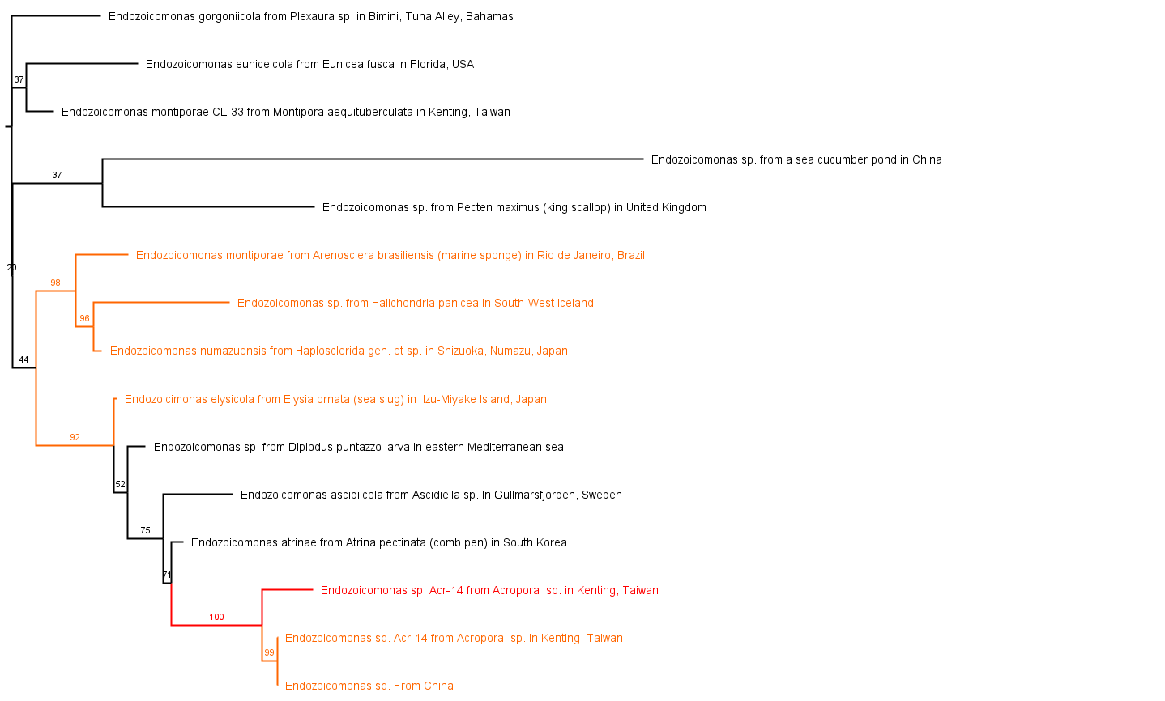
Endozoicomonas bacteria phylogeny inferred in a likelihood analysis of 15 16S rRNA sequences using TIM3+I+G4 model. Bootstrap values are labeled on the branches, orange being above 90%, and red being 100% support values. Taxon label includes the location of sampling, as well as the species from which it was sampled from (the host). The list was based off of Picking sequences was influenced by Pike et al. (2013).

Slide 2
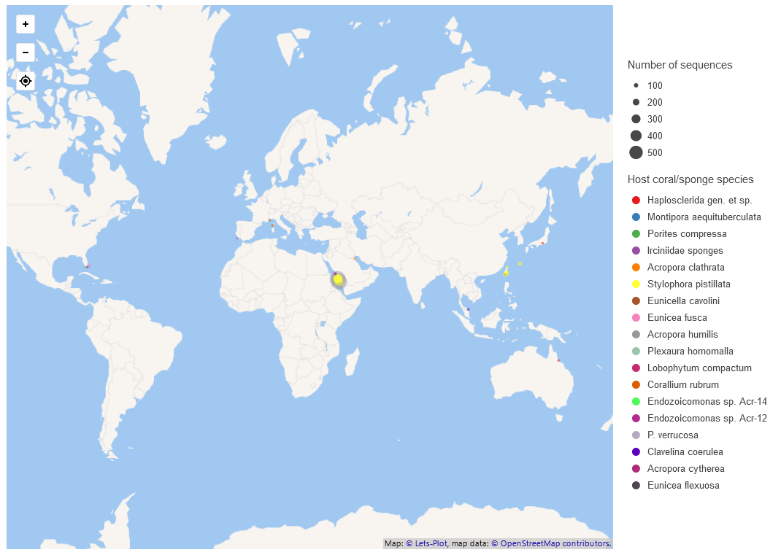
Mapping of location of included a mix of 140 Endozoicomonas and bacterial clone (not explicitly uploaded as Endozoicomonas sp.) 16S sequences with latitude and longitudinal on a map using pandas, geopandas, lat_long_parser and Lets-Plot (with OpenStreetMap). Size of dot correlates to number of sequences, while color indicate the sample’s host species. Samples come from Australia, France, Portugal, US (Florida and Hawai’i), Bahamas, Malaysia, Saudi Arabia, Kuwait, Taiwan (Kenting, Yeh Liu, Green Island) and Japan (Shizuoka and Okinawa).

Slide 3
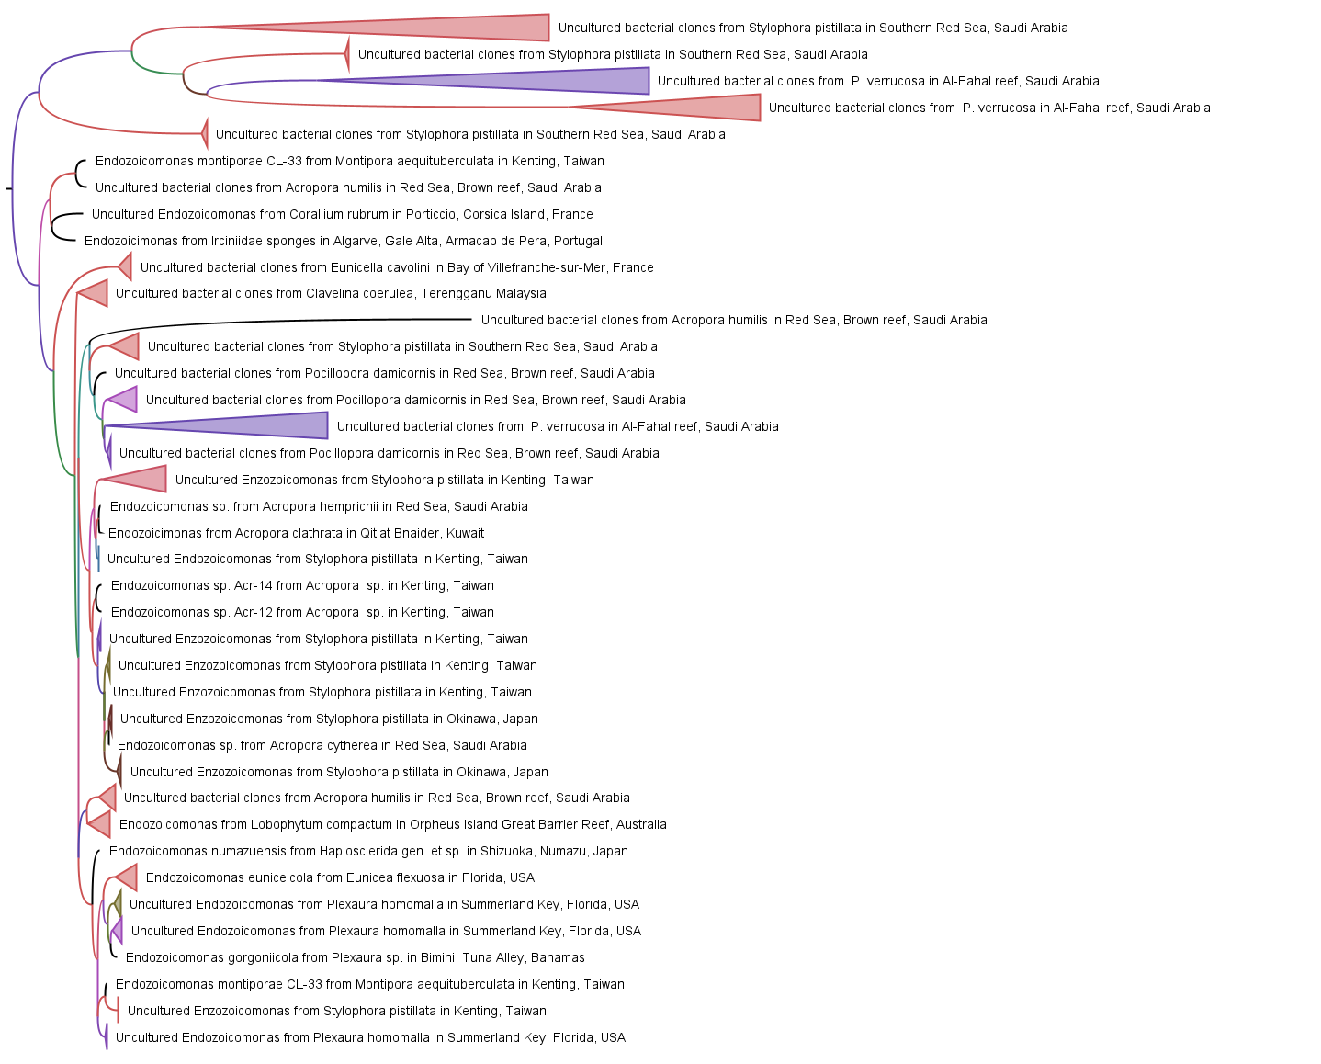
140 Endozoicomonas and bacterial clone phylogeny inferred in a continuous Bayesian phylogeographic analysis using 16S rRNA sequences, their latitude and longitudinal information and sampling dates with BEAST v1.10.4, HKY substitution model and classic priors. Posterior values are labeled on the branches, with purple transitioning to pink being 80-90%, and red being above 90% in support values. Taxon label includes the location of sampling, as well as the species from which it was sampled from (the host). Some clades (filled colors) were collapsed for brevity. Picking sequences was intentionally global in scope.

Slide 4
References
Ayres DL, Darling A, Zwickl DJ, Beerli P, Holder MT, Lewis PO, Huelsenbeck JP, Ronquist F, Swofford DL, Cummings MP, et al. 2011. BEAGLE: An Application Programming Interface and High-Performance Computing Library for Statistical Phylogenetics. Systematic Biology 61:170–173.
Barker CH. 2022. NOAA-ORR-ERD/lat_lon_parser : v1.3.0. Available from: https://github.com/NOAA-ORR-ERD/lat_lon_parser
BEAST Developers. 2019. Phylogeographic diffusion in continuous space - YFV example. Available from: https://beast.community/workshop_continuous_diffusion_yfv
Cock PJA, Antao T, Chang JT, Chapman BA, Cox CJ, Dalke A, Friedberg I, Hamelryck T, Kauff F, Wilczynski B, et al. 2009. Biopython: freely available Python tools for computational molecular biology and bioinformatics. Bioinformatics 25:1422–1423.
Darriba D, Posada D, Kozlov AM, Stamatakis A, Morel B, Flouri T. 2019. ModelTest-NG: A New and Scalable Tool for the Selection of DNA and Protein Evolutionary Models. Molecular Biology and Evolution 37:291–294.
Edgar RC. 2022. High-accuracy alignment ensembles enable unbiased assessments of sequence homology and phylogeny. bioRxiv.
Jordahl K, den Bossche JV, Fleischmann M, Wasserman J, McBride J, Gerard J, Tratner J, Perry M, Badaracco AG, Farmer C, et al. 2020. geopandas/geopandas: v0.8.1. Available from: https://doi.org/10.5281/zenodo.3946761
Kozlov AM, Darriba D, Flouri T, Morel B, Stamatakis A. 2019. RAxML-NG: a fast, scalable and user-friendly tool for maximum likelihood phylogenetic inference. Bioinformatics 35:4453–4455.
Lets-Plot contributors, Dovdaiytis V. 2023. JetBrains/lets-plot: v4.1.0. Available from: https://github.com/JetBrains/lets-plot
McKinney W. 2010. Data Structures for Statistical Computing in Python. In: van der Walt S, Millman J, editors. Proceedings of the 9th Python in Science Conference. pp. 56–61.
Nguyen L-T, Schmidt HA, von Haeseler A, Minh BQ. 2014. IQ-TREE: A Fast and Effective Stochastic Algorithm for Estimating Maximum-Likelihood Phylogenies. Molecular Biology and Evolution 32:268–274.
OpenStreetMap contributors. 2023. Planet dump retrieved from https://planet.osm.org. Available from: https://www.openstreetmap.org
pandas development team T. 2023. pandas-dev/pandas: Pandas. Available from: https://doi.org/10.5281/zenodo.10107975
Pike RE, Haltli B, Kerr RG. 2013. Description of Endozoicomonas euniceicola sp. nov. and Endozoicomonas gorgoniicola sp. nov., bacteria isolated from the octocorals Eunicea fusca and Plexaura sp., and an emended description of the genus Endozoicomonas. International Journal of Systematic and Evolutionary Microbiology 63:4294–4302.
Rambaut A, Drummond AJ, Xie D, Baele G, Suchard MA. 2018. Posterior Summarization in Bayesian Phylogenetics Using Tracer 1.7. Systematic Biology 67:901–904.
Tamura K. 1992. Estimation of the number of nucleotide substitutions when there are strong transition-transversion and G+C-content biases. Molecular biology and evolution 9:678–687.

